Slide 1
Monitoring SQL Server Replication
Presenter : Jim Katsos

Slide 2
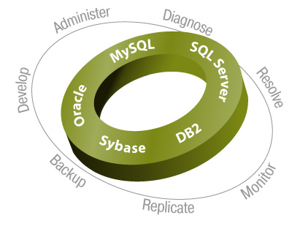
Expect more from your Databases
Improve DBA and developer productivity and increase database performance with market-leading database management products.
Quest Solutions for
Database Management
Notes:
We improve DBA and developer productivity and increase database performance with market-leading database management products.
For example, more than 500,000 IT professionals use our Toad product line to develop and administer their databases applications.
Our database management tools are available for Oracle, IBM DB2, Sybase, MySQL and Microsoft SQL Server.
[ CLICK ]

Slide 3
What will we cover today?
Briefly explain how SQL Server replication works
Types of Replication provided by SQL Server and what to monitor
How to monitor SQL Server Replication
Demo Spotlight on SQL Server Replication BETA

Slide 4
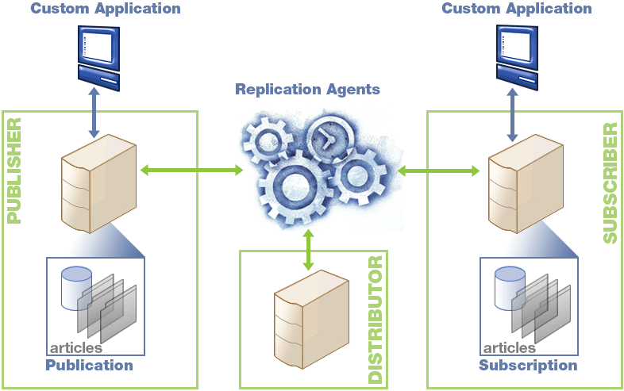
Basic concepts

Slide 5
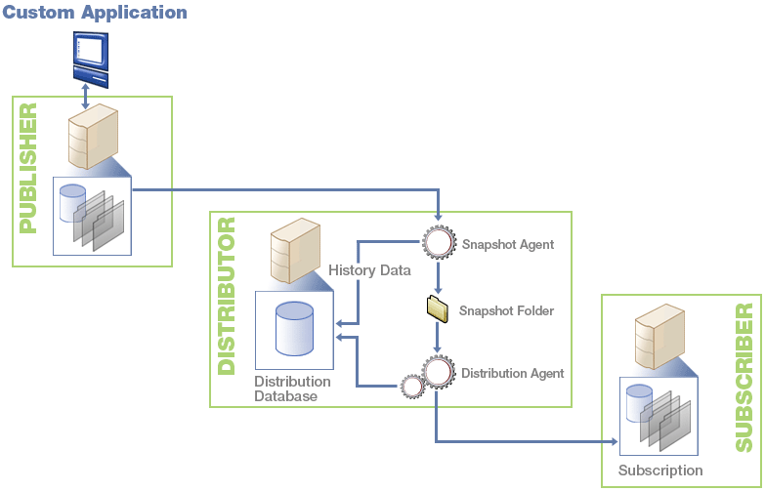
Snapshot Replication
Agents Status
Duration of Snapshot generation process

Slide 6
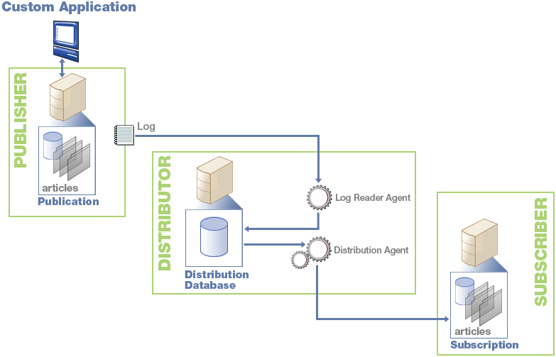
Transactional Replication
Agents status
Latency
Through-put
Undistributed Commands
Size of distribution database/tables (MSrepl_commands, MSrepl_transactions)

Slide 7
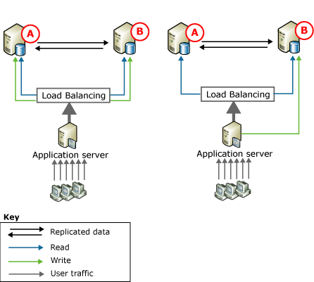
Transactional Replication - Peer to Peer in 2005

Slide 8
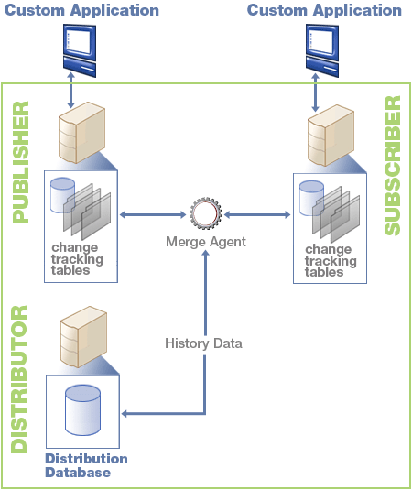
Merge Replication
Agent status
Duration of merge session
Through-put
Undistributed commands
Conflict Counts
Size of Tombstone, Contents table

Slide 9
How to monitor Replication
Management studio and Replication Monitor
  Demo
Write your own
  T-SQL
  RMO

Slide 10
Monitoring transactional replication performance using T-SQL
LogReader and Distribution Agent Latency and Through-put
  From distributor
    sys.dm_os_performance_counters, sysperfinfo
Undistributed commands
  From published database for LogReader agent
    exec sp_repltrans
  From distribution database for Distribution Agent
    MSdistribution_status
    sp_browsereplcmds
Size of change Tracking tables
  From distribution database
    MSrepl_commands, MSrepl_transactions

Slide 11
Monitoring merge replication performance using T-SQL
Merge agent throughput, conflicts, session duration
  From distributor
    MSmerge_sessions, MSmerge_history
Undistributed commands
  From published and subscriber database
    MSmerge_contents, MSmerge_tombstone, MSmerge_genhistory
Size of change Tracking tables
  From published and subscriber database
    MSmerge_contents, MSmerge_tombstone

Slide 12
RMO – Remote management objects
Show objects in Visual Studio.

Slide 13
A new monitoring tool
Spotlight on SQL Server Replication.

Slide 14
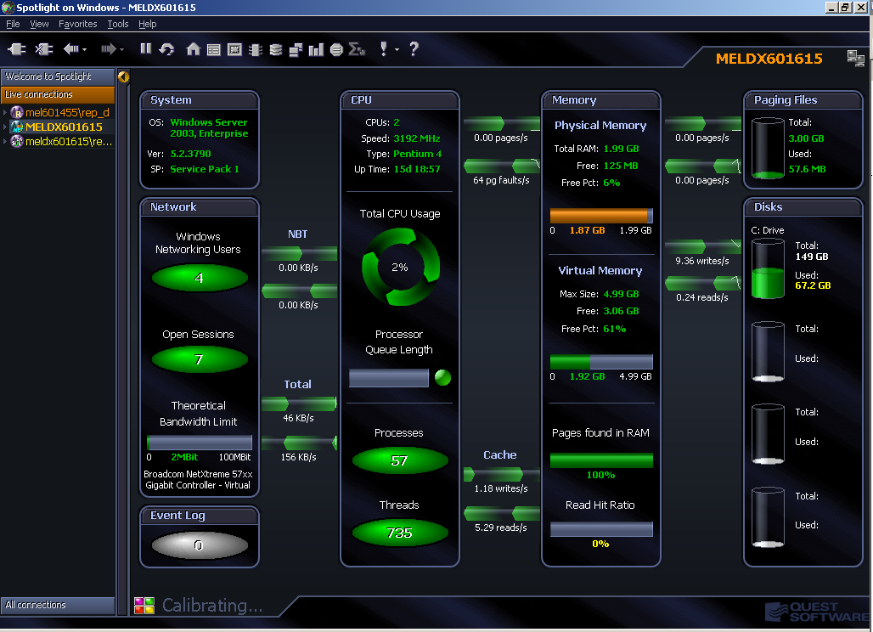

Slide 15
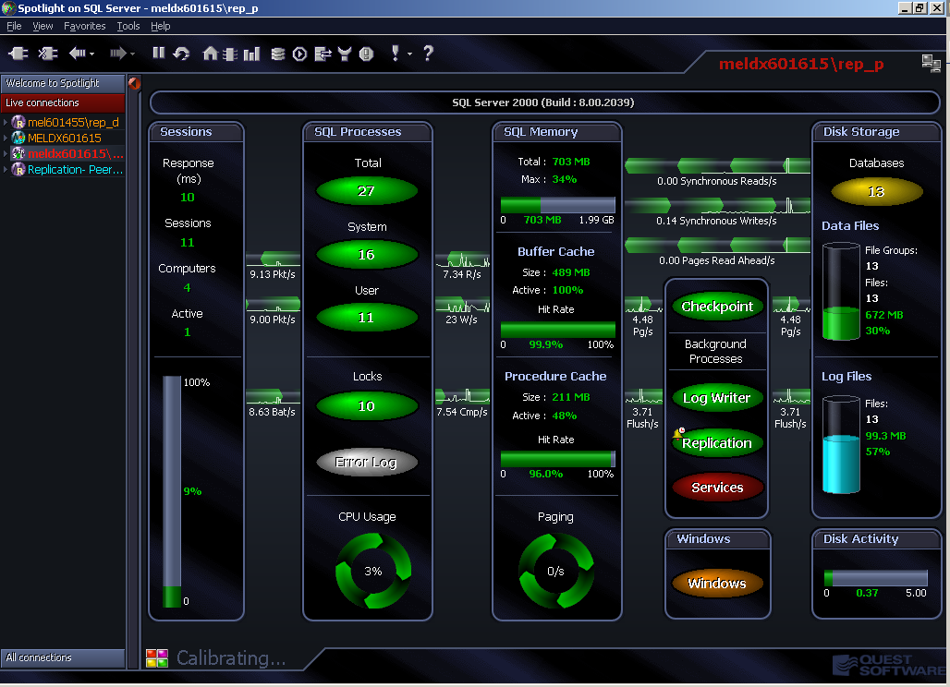

Slide 16
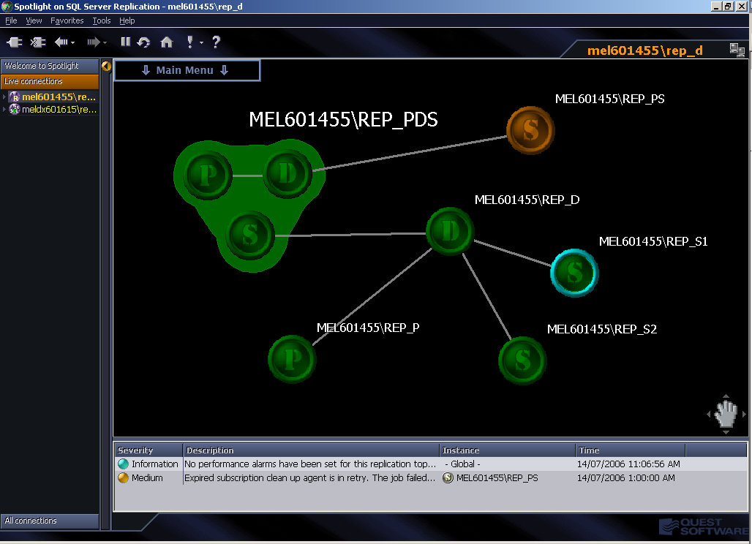

Slide 17
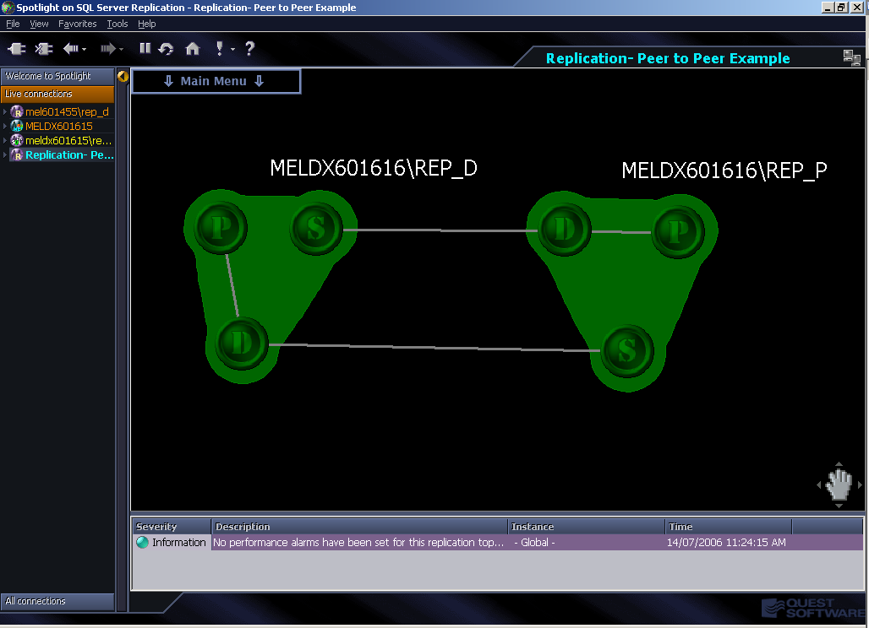

Slide 18
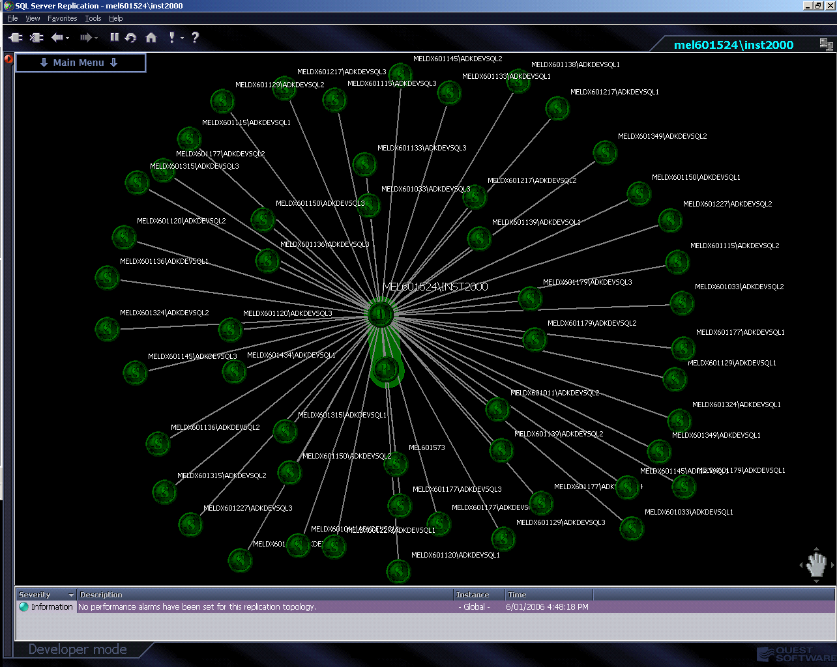

Slide 19
Spotlight on SQL Server Replication
Participate in our BETA program, register at:
http://www.quest.com/beta/
Also download Spotlight on SQL Server and Spotlight on Windows free 30 day trial at:
http://www.quest.com/sql_server/

